Slide 1

A Real time field based Research mini project on
Iot Based On Waste Bins Monitoring In Smart Cities
SUBMITTED BY:
E. John Moses - 22W95A0405
G. Nikhil Goud -21W91A0434
D. Abhinaya -22W95A0404
B. Sai Rahul Yadav -21W91A0412
Project Guide:
Mr. D Narasimha
Assistant Professor
Department of ECE
MRIET

Slide 2

CONTENTS
Abstract
Introduction
Aim
Objectives
Scope
Existing System & its limitations
Proposed System &its Advantages
Block Diagram
Software & Hardware Requirement
Output
Conclusion

Slide 3

IoT-Based Waste Bin Monitoring in Smart Cities
This presentation explores an IoT-based waste bin monitoring system using Arduino, sensors, and WiFi, aimed at improving waste management in smart cities.

Slide 4

Abstract
Real-time Waste Level Monitoring
Our system provides real-time updates on waste levels in bins.
This study proposes an IoT-based smart waste management system to address the challenges of waste generation in smart cities.
Efficient Waste Collection
The system optimizes waste collection by ensuring timely removal.
Smart City Infrastructure
The system enhances waste management in a smart city environment.

Slide 5
Introduction
Urbanization Challenges
Waste Management Concerns
Rapid urbanization leads to increased waste generation.
In the context of smart cities, efficient waste management plays a crucial role in maintaining cleanliness and sustainability
Inadequate waste management leads to environmental and health issues.
Traditional waste collection methods often lack real-time data insights, leading to inefficiencies in resource allocation and service delivery.

Slide 6
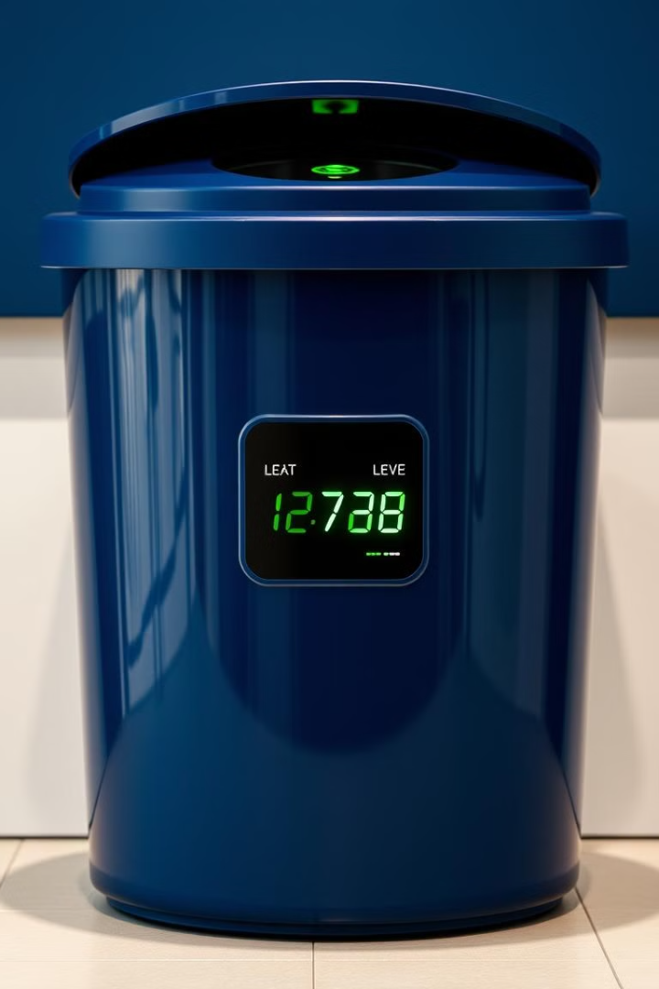
Aim
This project aims to design and develop an IoT-based system for monitoring waste levels in bins, enabling timely waste collection and reducing overflow.

Slide 7

Objectives
1
1. Waste Level Detection
2
2. Data Transmission
3
3. Real-time Display
Send data to a cloud platform via a WiFi module.
Display waste levels in real-time on an LCD screen.
Employ sensors to accurately detect waste levels.

Slide 8




Scope
1
Smart Cities
2
Efficient Waste Management
3
Reduced Overflow
4
Improved Cleanliness

Slide 9
Existing System and Limitations
Manual Monitoring
Overflowing Bins
Waste bins are monitored manually by workers.
Bins often overflow due to delayed collection.
These methods result in higher operational costs, increased fuel consumption, and
environmental pollution. Moreover, they lack real-time data, making it difficult to optimize routes and respond to varying waste generation patterns effectively.

Slide 10




Proposed System and Advantages
IoT-Based Monitoring
Real-time Updates
Improved Efficiency
Sensors collect waste level data and transmit it via WiFi.
Data is sent to a central server for analysis and alerts.
Alerts enable timely waste collection, reducing overflow.

Slide 11
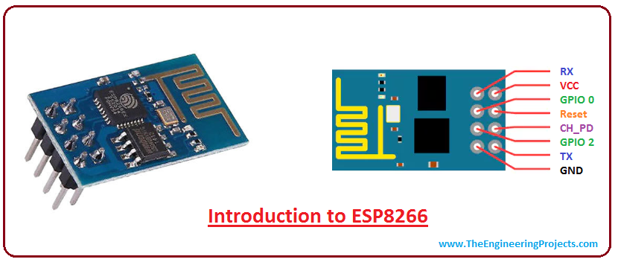
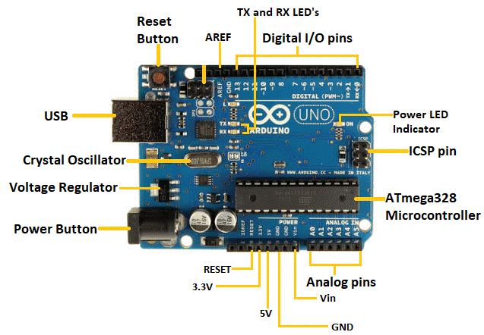
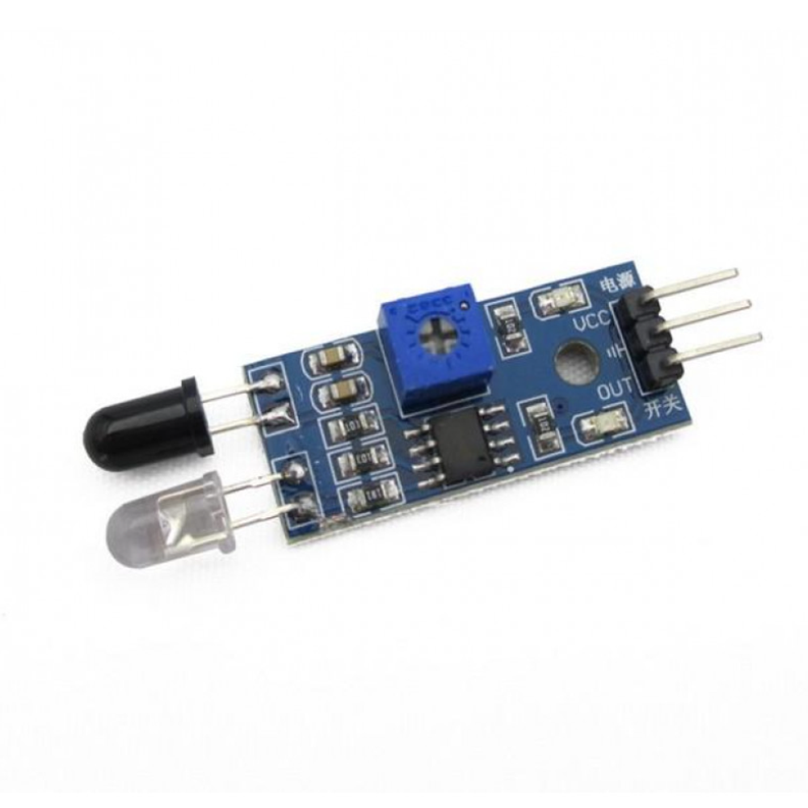
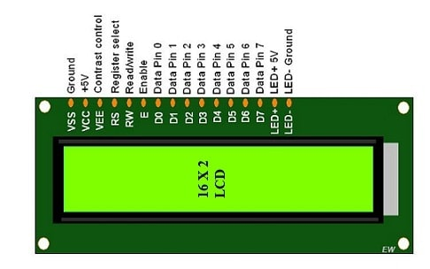
Components used
WI-FI MODULE
ULTRA SONIC SENSOR
IR SENSOR

Slide 12
Block Diagram
ARDUINO UNO
CONTROLLER
LCD
POWER
SUPPLY
BUZZER
RED LED
ULTRASONIC
SENSOR
GREEN LED
ESP 8266
WIFI
MODULE

Slide 13





Software Requirements
Arduino UNO
Ultrasonic & IR Sensors
The microcontroller board for system control.
Used for detecting waste levels.
ESP8266 WiFi Module
16x2 LCD Display
Enables wireless data transmission.
Provides real-time waste level display.

Slide 14
Hardware Requirements
Arduino Uno
Ultrasonic sensors
Wi-Fi module
Power supply
Buzzer
Led –Red,Green
IR Sensor

Slide 15
Output
The system provides real-time data on waste bin fill levels, transmitted via Wi-Fi to a central server.
This data enables optimized waste collection routes, reducing unnecessary trips and operational costs.
Alerts notify waste management teams when bins are nearly full, preventing overflow. Historical data generates reports for strategic planning, enhancing overall efficiency.

Slide 16
Conclusion
The IoT-based waste bins monitoring system enhances urban waste management by optimizing collection routes and reducing costs.
It prevents bin overflow through real-time alerts and improves cleanliness.
The system supports data-driven decisions and can be scaled for broader implementation, contributing to the sustainability and efficiency of smart cities.

Slide 17


Slide 18


